Slide 1
New Construction Pricing Problem
Zillow Data Science

Slide 2
Agenda
Problem Statement
Scope
Analysis
Insights/Recommendations
Appendix

Slide 3
Problem Statement
Should Zillow’s New Construction sales team charge their customers a flat price per Community or per Lead Received?
Community : It is a collection of homes owned by a builder.
Lead : A lead is when consumer on Zillow chooses to contact the builder about a specific community

Slide 4
Scope
As of January 2016 , Zillow has 6,174 New Construction Communities advertising and delivers an average of 4.00 Leads per Community per Month to existing customers.
Two key priorities:
1) Prioritizing long-term revenue opportunity over short-term.
2) Providing the best experience for the consumer possible (More listings is better)
Pricing Options:
$40 per lead
$400 per community

Slide 5
Below are Financial Planning and Analysis team estimates:
Leads per Community per Month are expected to grow at the following rates Month-Over-Month:
o 2016: 5% MoM growth every month
o 2017: 4% MoM growth every month
o 2018: 1% MoM growth every month
Similarly, Zillow’s expected number of New Construction communities advertising on the site is expected to grow at the following rates Month-Over-Month for the Pay Per Lead model:
o 2016: 6% MoM growth every month
o 2017: 4% MoM growth every month
o 2018: 2% MoM growth every month
However, with the $400 Price Per Community their model believes that the Community Month-Over-Month growth rate will be only 90% the rate of Price per Lead model as they expect a higher cancellation rate. (For Example: 6%*0.9; 4%*0.9; and 2%*0.9)

Slide 6
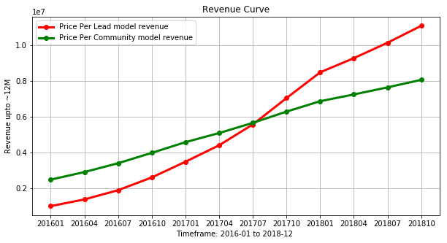
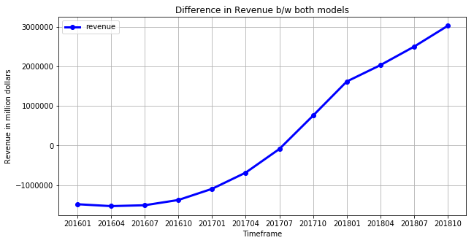
Revenue Impact
On a long term perspective, Price per Lead model returns high revenue compared to Price Per Community model
As of Dec’18, revenue impact of Price per Lead model is 11.7M, Price per Communities model is 8.3M and started as of Jan’16 at 987K and 2.4M resp.

Slide 7
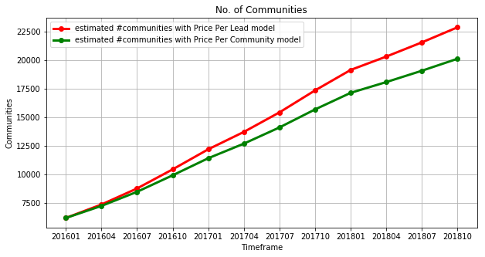
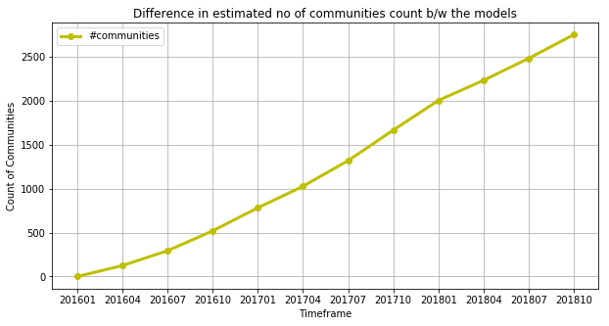
Community Growth Curve
As of Dec’18, no. of communities as per Price per Lead model are estimated to growth from 6174 to ~23K and to ~20K as per Price Per Community model

Slide 8
Insights/Recommendations
Based on the given financial planning estimates, focusing on long term profitability perspective, Price per leads model wins over price per community model. However, in case if there were a lot of communities with fewer house listings, then Price per community model may win over price per leads model.
In case where house listings on communities are high, implies that no of leads from them could also be high and if we charge builders based on price per community, it might lower profitability..
To strike a balance,my recommendation is to come up with a categories of communities based on the no of house listings in each community. For example,
Type1 community: house listings count between 2-10;
Type2 community: house listings count between 11-30;
Type3 community: house listings count between 31-50;
Type4 community: house listings count between 50-100;
Type5 community: house listings count between 101+ etc based on communities data.
Once, we have different categories of communities, we need to come up with an average estimate of leads expected from each community category and decide on price per lead

